Slide 1
An Intelligent Database System for Food Nutrition Analysis and Prediction
YOUNGSTOWN STATE UNIVERSITY
Capstone Project Presentation
Team members:
KANCHANA GANGA VELURU Y00877425
DEETYA REDDY NEERUGUTTI Y00886336
RAJESHWARI BHOOMIREDDY Y00879914
Notes:
Good morning, we are presenting our capstone project titled An Intelligent Database System for Food Nutrition Analysis and Prediction.
This project focuses on combining database systems, analytics, and machine learning.”

Slide 2
Introduction
Nutrition data is large and complex
Difficult to manage and analyze efficiently
Databases help organize structured data
Machine learning enables calorie prediction
This project integrates Database + Analytics + ML
Notes:
“Nutrition data is large, complex, and often difficult to analyze. Traditional methods are not efficient for handling such data. Databases help organize structured data, while machine learning helps in prediction. So, our project integrates database systems with analytics and machine learning.”

Slide 3
Background
Food datasets contain multiple nutrients per dish
Traditional flat tables lead to redundancy
Normalized relational databases improve efficiency
SQL enables powerful analytical queries
ML models can predict calories based on nutrients
Notes:
“Food datasets contain multiple nutrients for each dish. If stored in flat tables, they create redundancy and inefficiency. Using relational databases helps reduce redundancy and improves performance. SQL allows us to perform powerful queries, and machine learning helps in predicting calorie values.”

Slide 4
Problem Statement
Unstructured and inconsistent nutrition datasets
Data redundancy in flat storage systems
Limited analytical capabilities using raw data
No predictive mechanism for calorie estimation
Need for an integrated database-driven solution
Notes:
“The main problem we identified is that food nutrition datasets are often unstructured and inconsistent. They contain redundant data when stored in flat tables, which leads to inefficiency. It is also difficult to perform fast and meaningful analysis using raw data. Additionally, there is no proper system to predict calorie values. So, we needed a solution that combines structured data storage with analytical and predictive capabilities.”

Slide 5
OBJECTIVES
Design a normalized database (3NF)
Implement ETL for data cleaning
Perform SQL-based analytics
Develop ML models for calorie prediction
Visualize insights for decision-making
Notes:
“The objective of our project is to design a system that efficiently stores and analyzes nutrition data. We aimed to build a normalized database to remove redundancy and ensure data integrity. We also implemented an ETL process to clean and prepare the dataset. Using SQL, we performed analytical queries to extract insights. Finally, we developed machine learning models to predict calorie values and visualize the results for better understanding.”

Slide 6
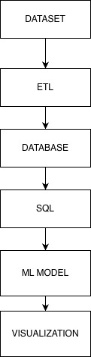
System Architecture

Slide 7

ER diagram
Entities
Dish – Stores food item details
Nutrient – Stores types of nutrients (calories, protein, etc.)
Dish_Nutrient – Links each dish with its nutrient values
Key Features
Eliminates data redundancy by separating food and nutrient data
Supports scalability by allowing new nutrients to be added easily
Ensures data integrity using primary and foreign keys

Slide 8
Methodology
Designed normalized schema (3NF)
Built ETL pipeline (Python)
Loaded data into MySQL
Created SQL queries and views
Developed ML models
Notes:
“We followed a structured approach. First, we designed a normalized schema in 3NF. Then we built an ETL pipeline using Python to clean the data. Next, we loaded the data into MySQL and created SQL queries and views. Finally, we developed machine learning models for prediction.”

Slide 9
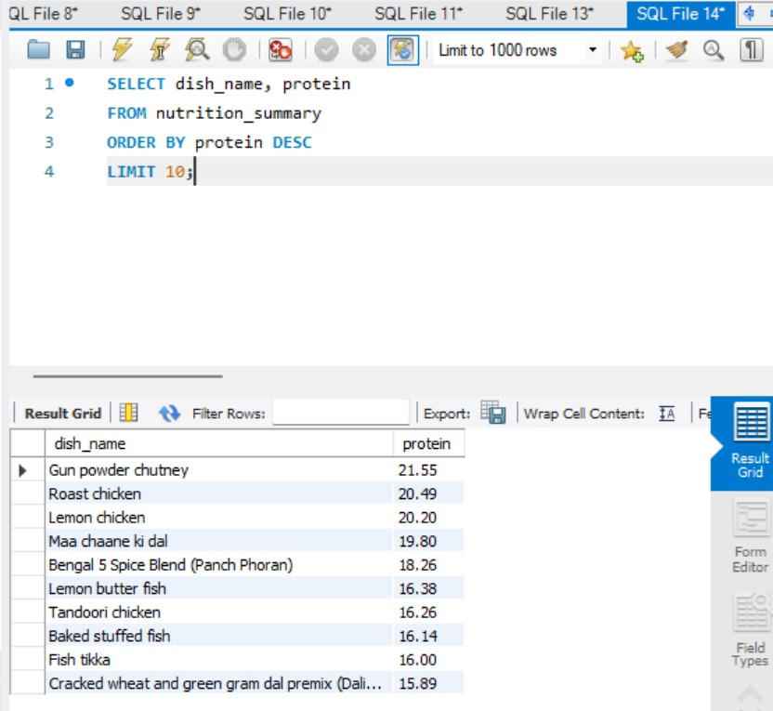
SQL ANALYTICS
Identified top high-protein food items
Used SQL sorting with ORDER BY
Helps in protein-based diet recommendations
Demonstrates efficient data filtering
Notes:
“Using SQL, we performed different types of analysis such as finding high-protein foods, low-calorie foods, and understanding nutrient distributions. This shows how databases can efficiently extract insights from data.”
“This query shows the top 10 high-protein foods from our database.
It demonstrates how SQL can be used to extract meaningful insights efficiently.”

Slide 10
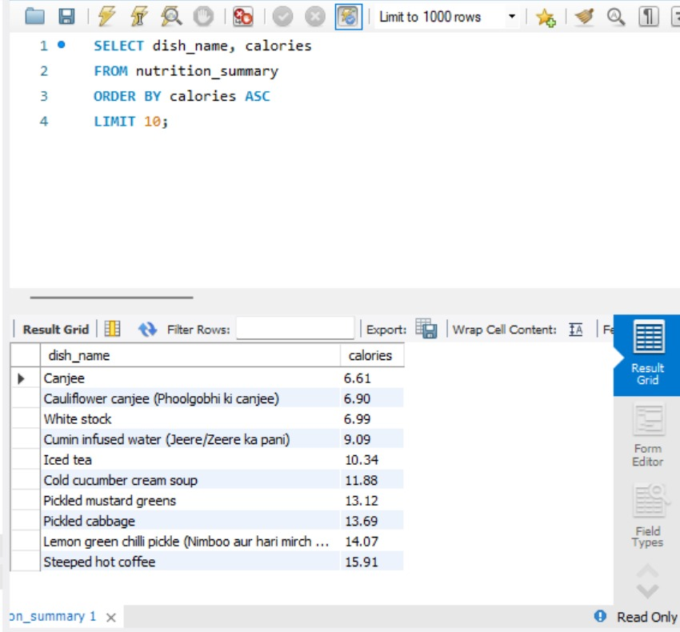
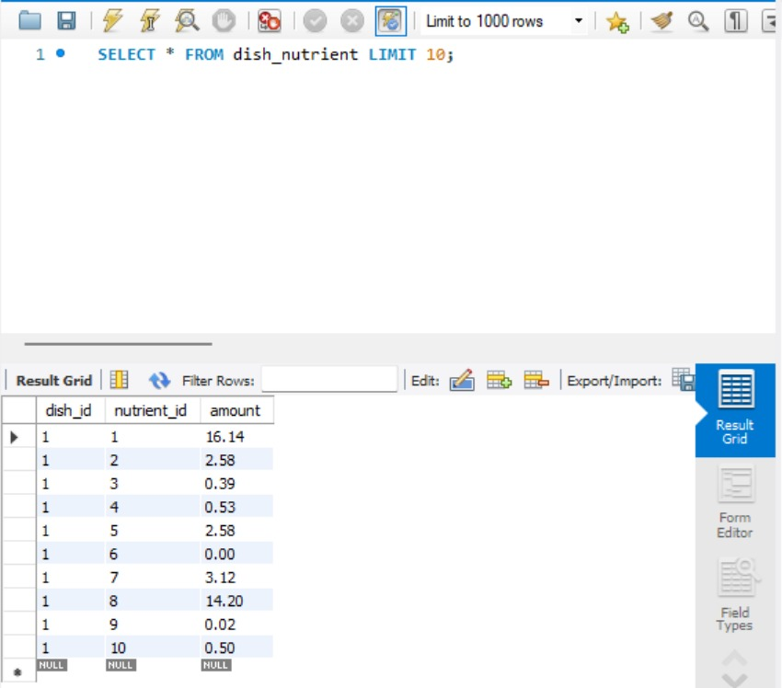
Notes:
Extracted low-calorie food options
Useful for weight management insights
Demonstrates ranking using SQL queries
Enables quick nutritional decision-making
This table stores nutrient values for each dish. Each dish is linked to multiple nutrients using dish_id and nutrient_id. This design avoids duplication and supports efficient analysis.”

Slide 11
MACHINE LEARNING
Models Used:
Linear Regression
Decision Tree
Random Forest
Setup:
Train-test split: 80/20
Features: Protein, Carbs, Fats
Target: Calories

Slide 12
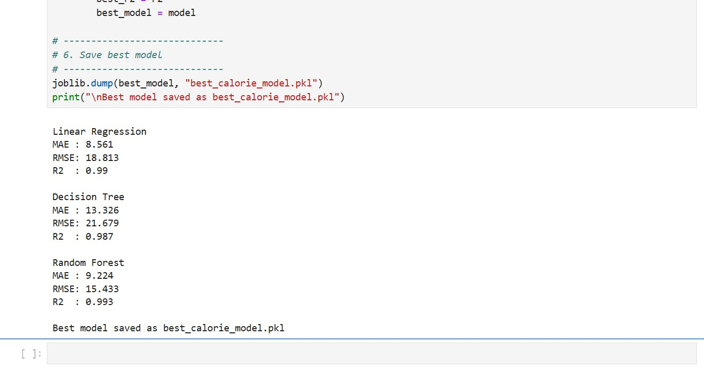
RESULT
Model Performance
Random Forest achieved the best performance
Outperformed Linear Regression and Decision Tree
Evaluation Metrics
MAE (Mean Absolute Error)
RMSE (Root Mean Square Error)
R² Score

Slide 13
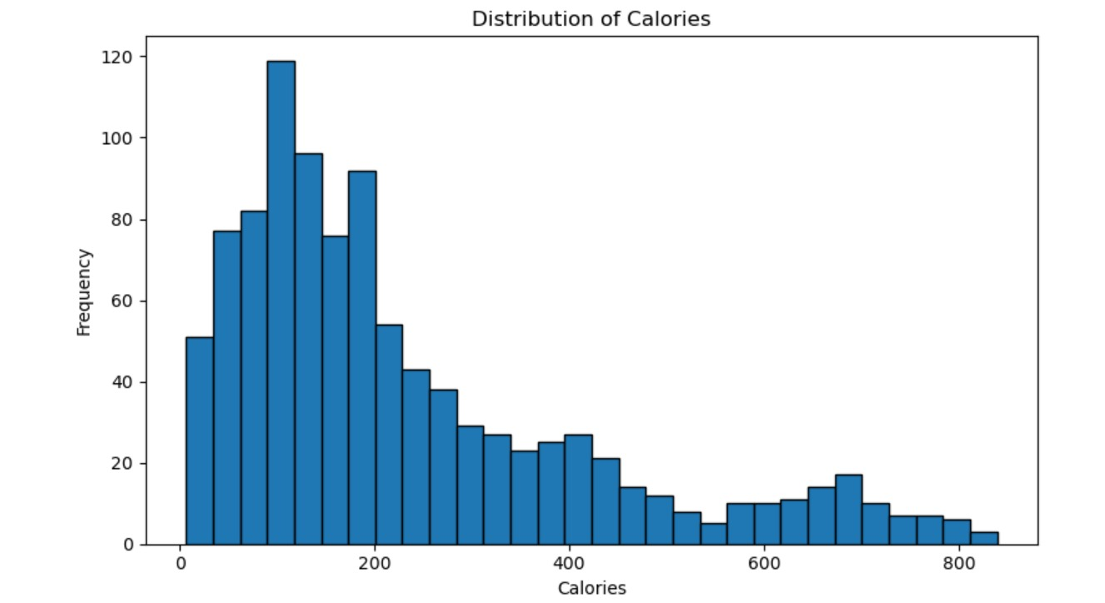
VISUALIZATION
Calories distribution

Slide 14
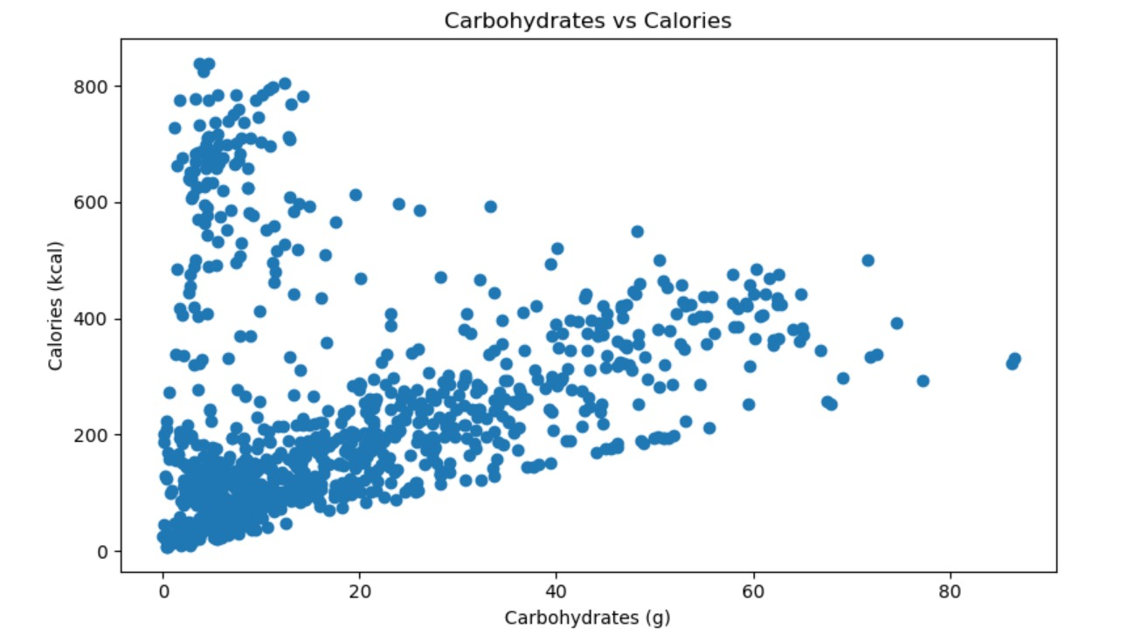
Carbs vs calories

Slide 15
Discussion
Strong correlation between nutrients and calories
SQL enabled fast data analysis
Indexing improved performance
ML models enhanced prediction accuracy
System supports data-driven decisions

Slide 16
Conclusion
Built a fully normalized database
Integrated ETL, SQL, and ML
Enabled efficient analytics
Achieved accurate calorie prediction
Demonstrated real-world data solution

Slide 17
Contribution of team members
Kanchana
ETL + SQL analytics
Deetya
ML + Visualization
Rajeshwari
Database + Evaluation

Slide 18
THANK YOU

